Slide 1
Cookbook Consumer Behavior Analysis From Amazon.com
Xing Fang, Yating Liu, Zi-Qi Liu, Tianrui Wang
Instructor: Professor Rong Liu

Slide 2
Introduction & Problem Statement
What key elements made up the best sellers in the book industry is one of the most concerned topics for publishers.
For long, customer reviews have been a doorway to analyzing consumer behavior and buying patterns for product introduction and improvement.
This project used unsupervised & supervised approaches
Analyzed different aspects of the best selling cookbooks on Amazon.com
Derived valuable consumer behavior patterns
Obtained consumer preferences and patterns to help the publishers in their book production lifecycles

Slide 3
Project Process
Data Collection & Web Scraping
Data Understanding
Clustering
Sentiment Analysis & Prediction
Word2Vec Modeling
& Interpretation
Web Scraping
Data Cleaning
Text Mining
Basic Statistics
K - Means
Topic Modeling
Naive Sentiment Analysis
CNN
Gensim
1
2
3
4
5

Slide 4
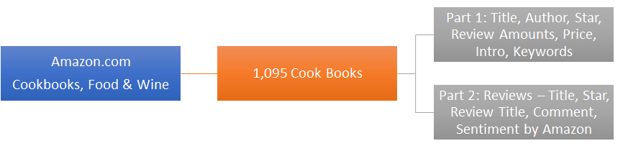
Collect Data: Web Scraping
We used Selenium Webdriver to scrape the data of 1,095 books from ‘Cookbooks, Food & Wine’ category on Amazon.com.
There are 9 main categories we are interested

Slide 5
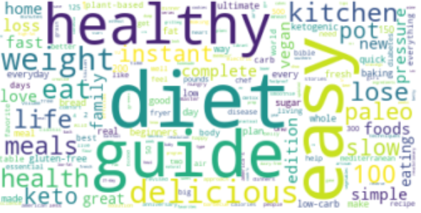
WordCloud of Book Titles

Slide 6
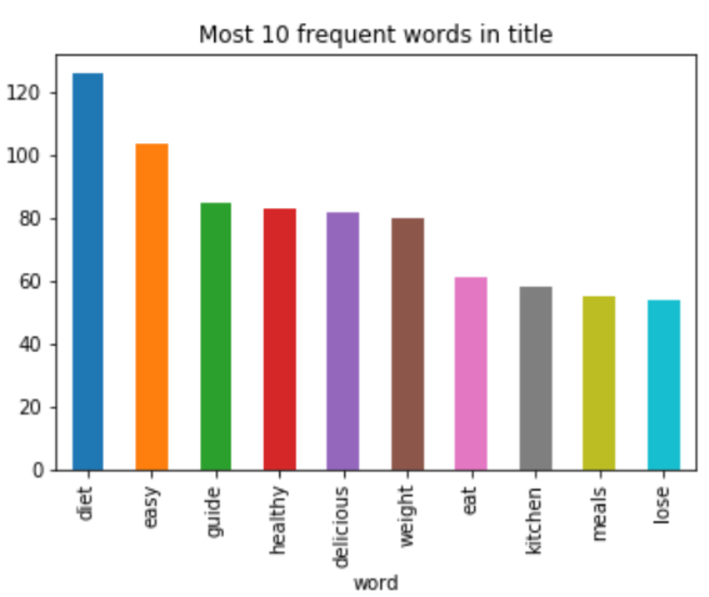
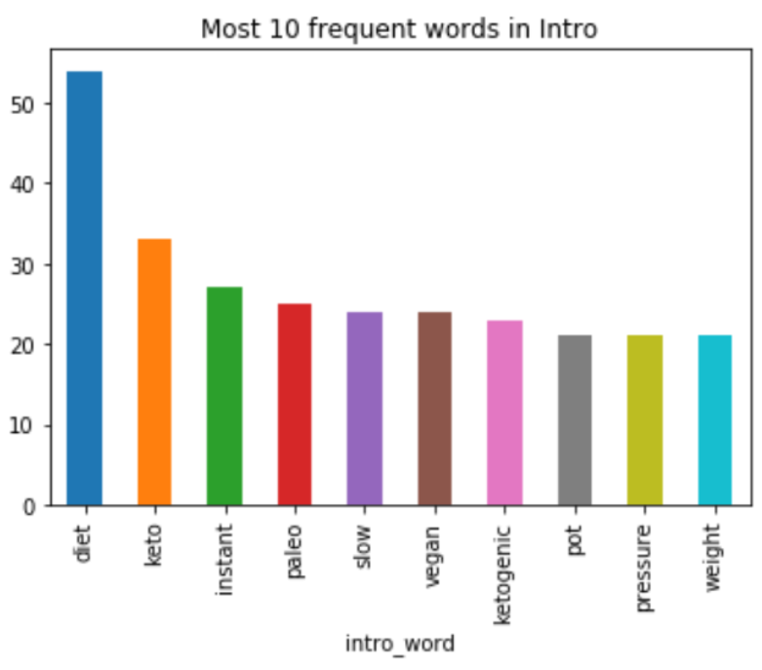
Top words: Title and Intro

Slide 7
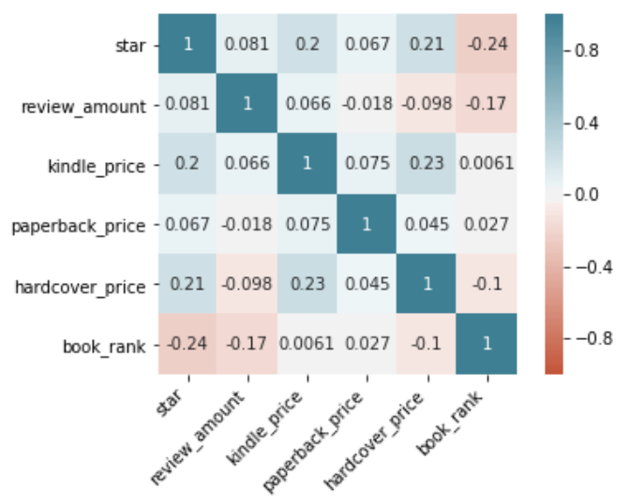
Variables Correlation
Positive correlation include: (hardcover_price, star), (kindle_price, star), (hardcover_price, kindle_price)
Negative correlation include: (book_rank, star), (book_rank,review_amount)

Slide 8
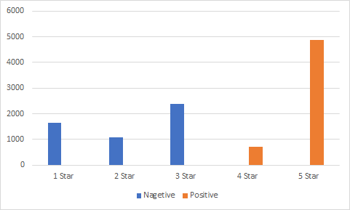
Amazon.com Sentiment Labels
After reviewing 10,685 reviews, we find out Amazon labels the sentiment based on the ratings of star.

Slide 9
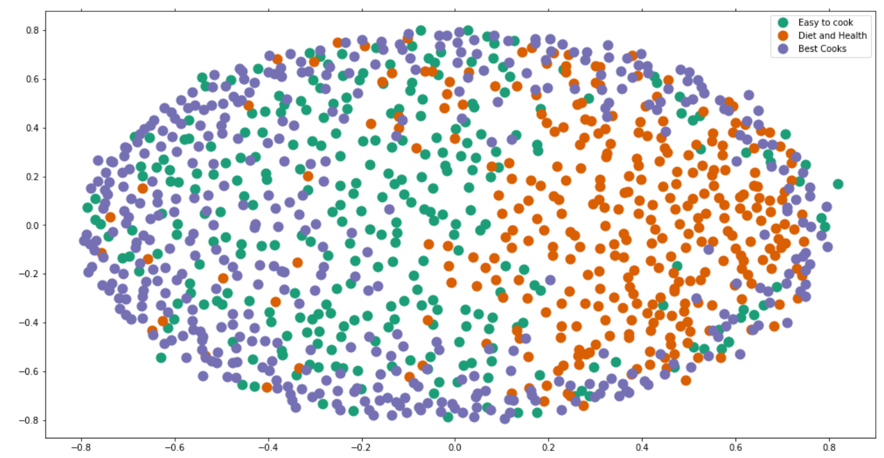

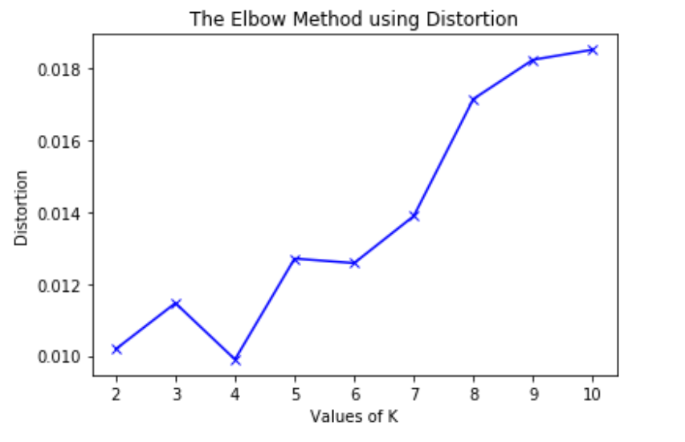
K-Means Clustering Based on Introduction + description
Filter all meaningless words, like cook, food, recipes
Find optimal number of clusters by using silhouette_score
local optima
KMeansClusterer( cosine distance, repeat = 20 )
Notes:
Y means the mean distance to the other instances in the same cluster. X depicts mean distance to the instances of the next closest cluster. So the higher the better.
And based on our plot, we can see more number of clusters, effect of clustering will be better. However with high number of clusters, the metric is computation expensive as the coeeficient is calculated for every instance.
And also, with more number of clusters, the features of each cluster will not be so obvious.
Finally we choose local optima 3.

Slide 10
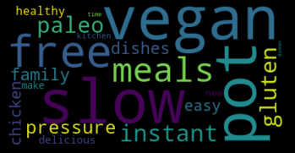
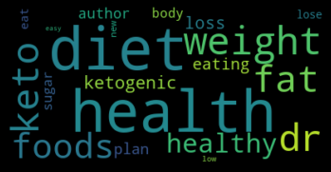
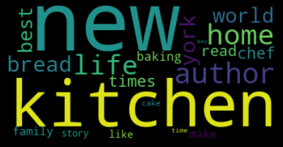
K-Means Clustering
Cluster 0: Easy to cook Cluster 1: Diet and Health Cluster 2: Popular Chefs

Slide 11
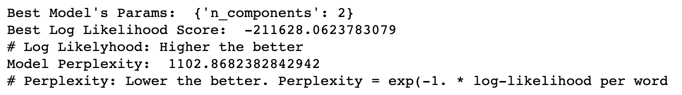
Topic Modeling on Book Reviews (10715 reviews)
Used LatentDirichletAllocation & gensim.models.ldamodel.LdaModel to do Topic Modeling on 10715 reviews
Used GridSearchCV to search for the best parameter for n_component:
Although the result showed that 2 components result in the best Log Likelihood & Perplexity
We decide to use n = 3 for convenience and consistency with the K-Means Clustering

Slide 12
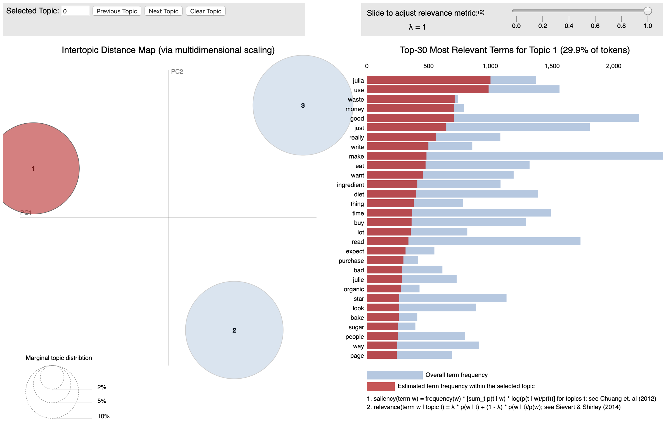
Topic Modeling on Book Reviews (10715 reviews)

Slide 13
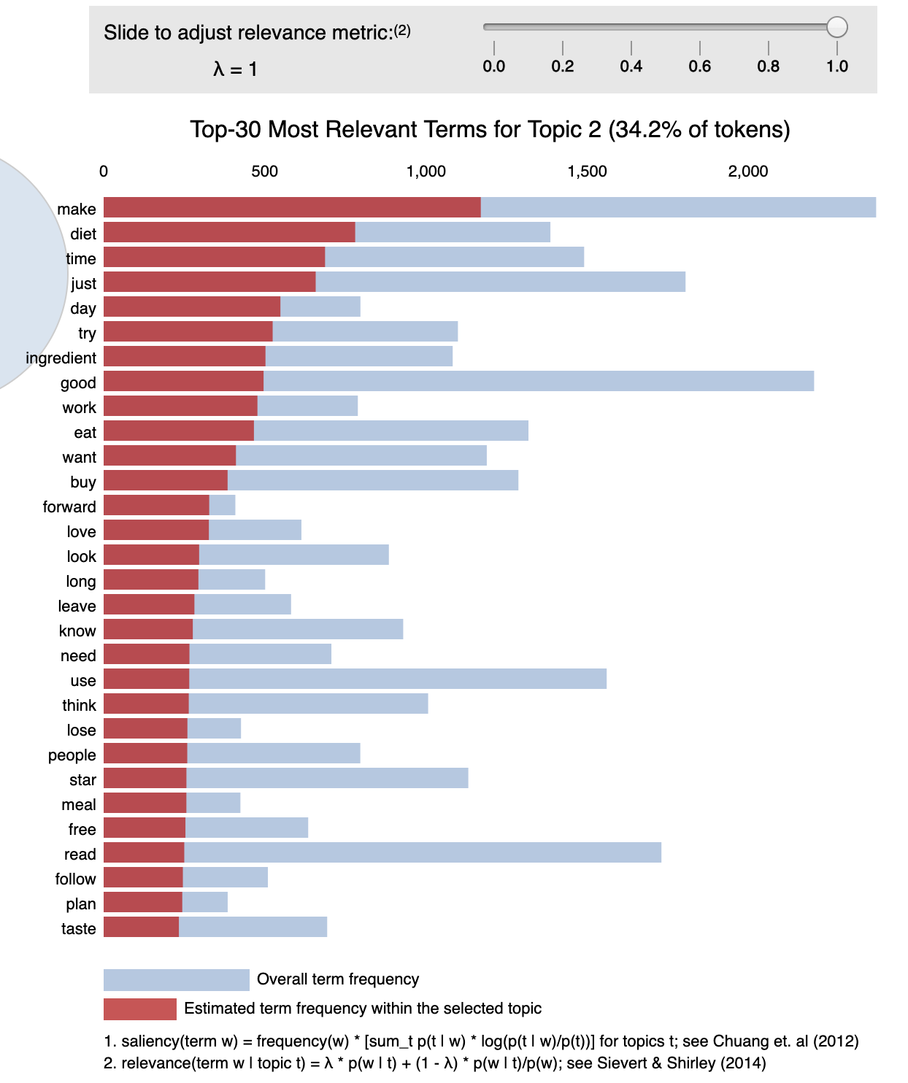
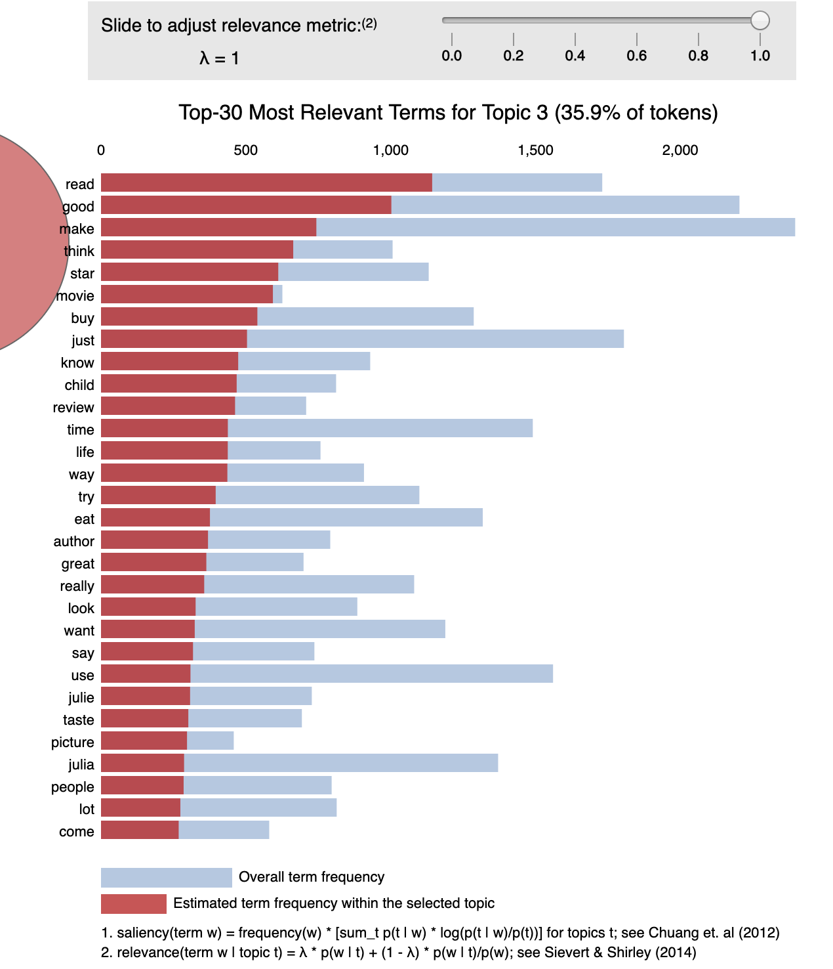
Topic Modeling on Book Reviews (10715 reviews)
Conclusion:
Probably not a good idea to do Topic Modeling directly on all reviews,
as reviews on different books will be mixed together.

Slide 14
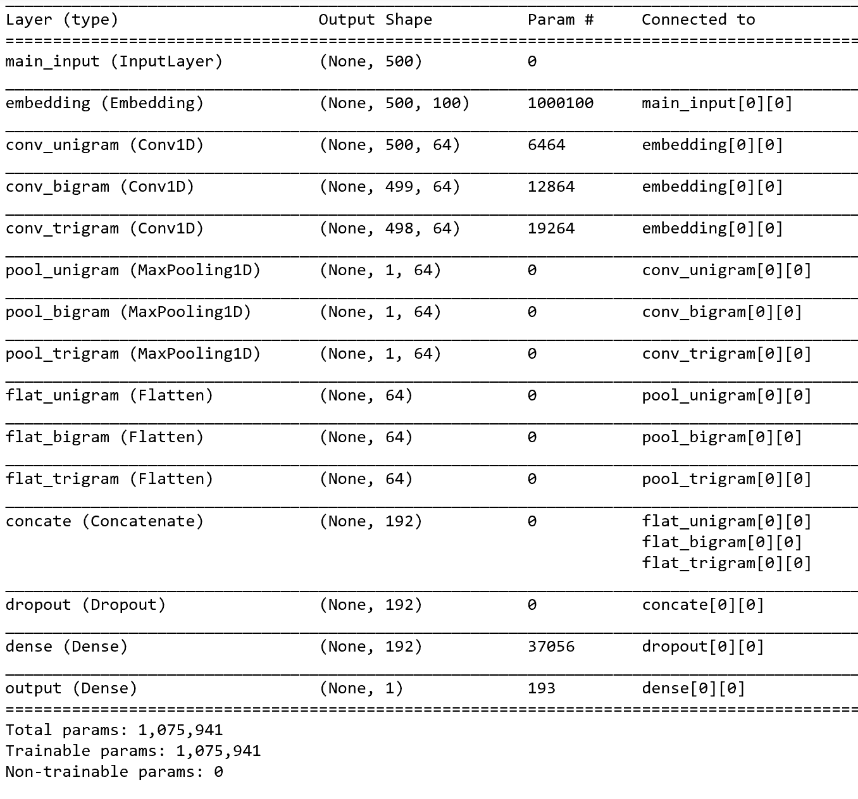
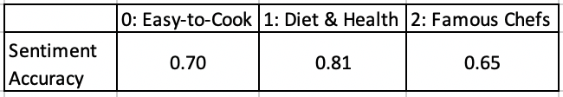
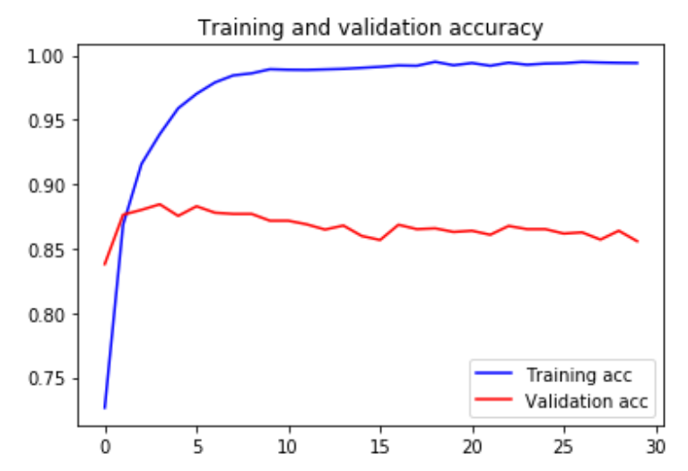
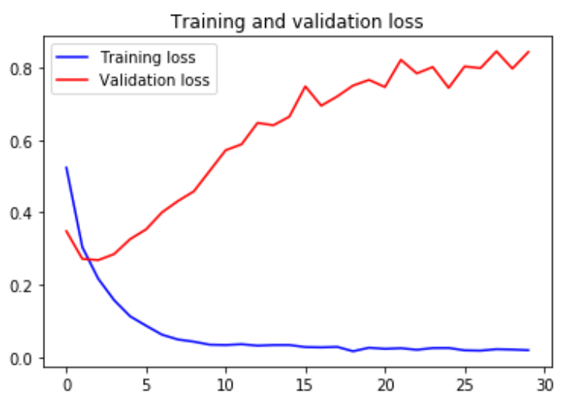
Sentiment Analysis
Based on 3 clusters - Naive
Based on the whole dataset - Naive
sentiment accuracy: 69%
Based on the whole dataset - CNN
Train:
Test : 85.58%
Notes:
So initially I did a naive sentiment analysis, which counts positive words and negative words after tokenization, then I determined the sentiment of reviews and compare the result with labels defined by Amazon. To evaluate the model, I test the accuracy with 3 clusters and the whole dataset. As you can see, the cluster of Diet and Health got a best accuracy as 0.81 while the accuracy of the whole dataset just as 0.69.

Slide 15
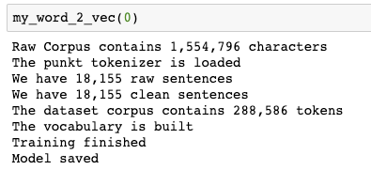
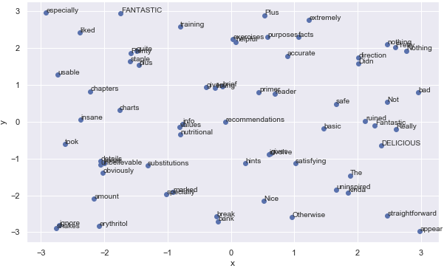
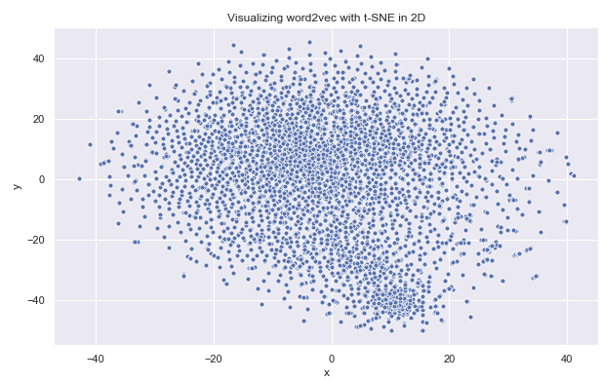
Word2Vec Modeling - ‘Easy to Cook’ Cluster
Aim: build up relationships between words to derive insights
Used all the review sentences from 3 clusters to build 3 word2vec model
Visualized the word vectors using t-SNE in 2D plane

Slide 16
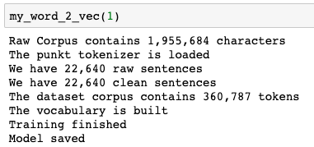
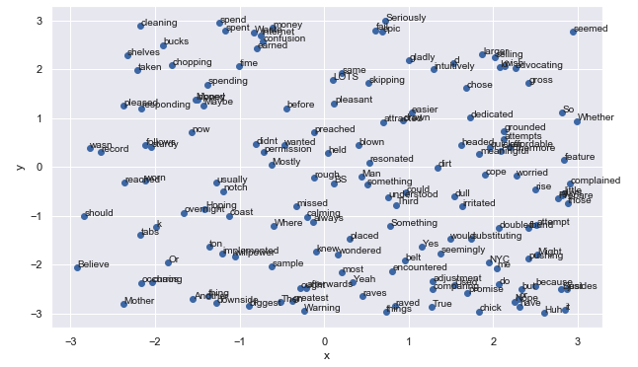
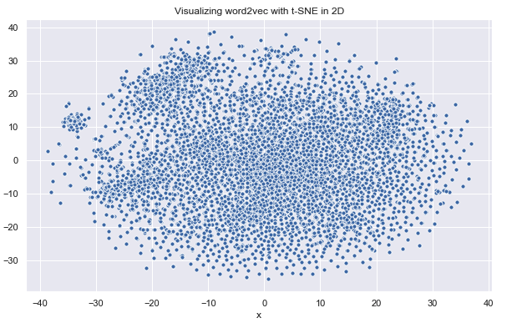
Word2Vec Modeling - ‘Diet & Health’ Cluster
Used all the review sentences from 3 clusters to build 3 word2vec model
Visualized the word vectors using t-SNE in 2D plane

Slide 17

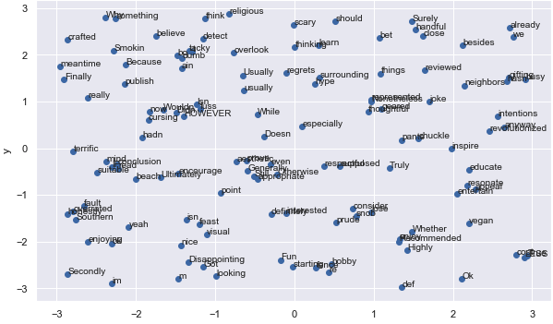
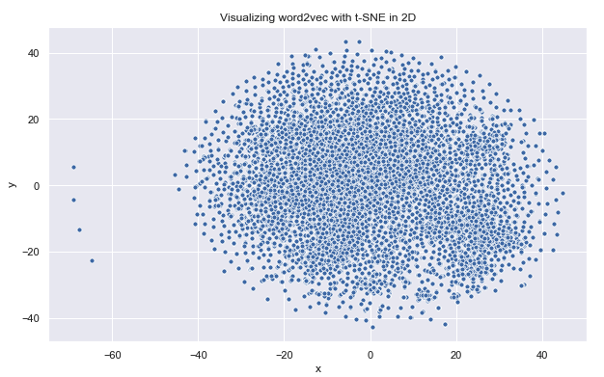
Word2Vec Modeling - ‘Popular Chef’ Cluster
Used all the review sentences from 3 clusters to build 3 word2vec model
Visualized the word vectors using t-SNE in 2D plane

Slide 18
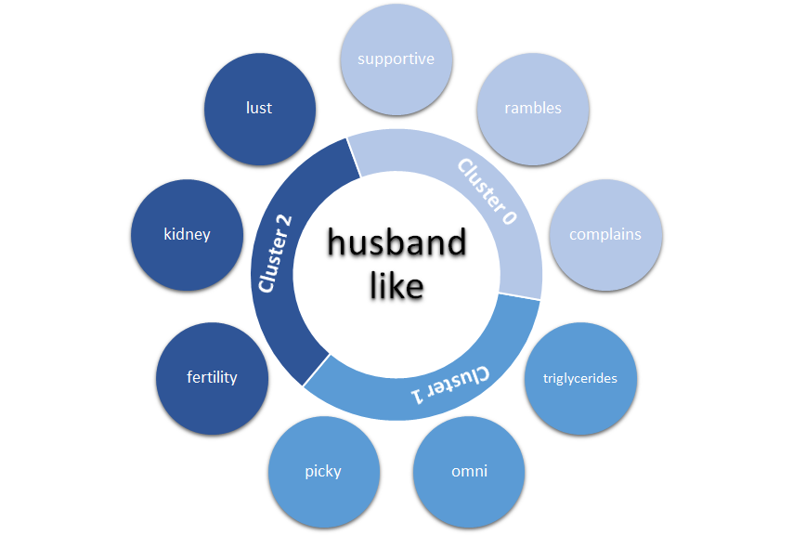
Implications on the
Age of Book Audiences
Based on Word2Vec Similarity Distance,
We targeted several customer groups and searched for their similar words.
Implies Married for a long time?
Issues for Young Couples
Notes:
When we search for words similar to ‘husband’ and ‘like’, we found an interesting phenomenon that the 3 clusters may indicate 3 age groups. Obviously, husbands of customers in cluster2 maybe young. In cluster1, omni means omnivorous and triglycerides, picky, seems like that kind of middle-aged men who may have hyperlipidemia, like eating, but also like to complain. Husbands belong to cluster0 are more likely to old men who are supportive their wives, like rambling but still like complaining.

Slide 19
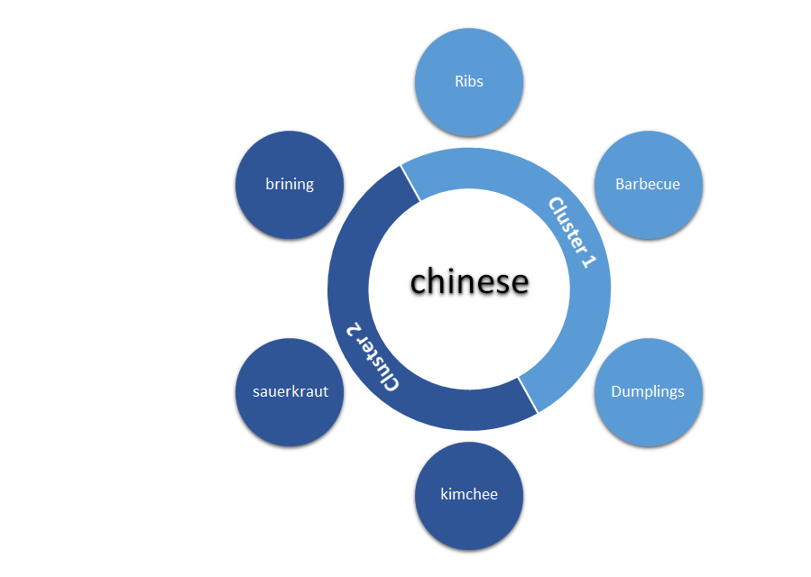
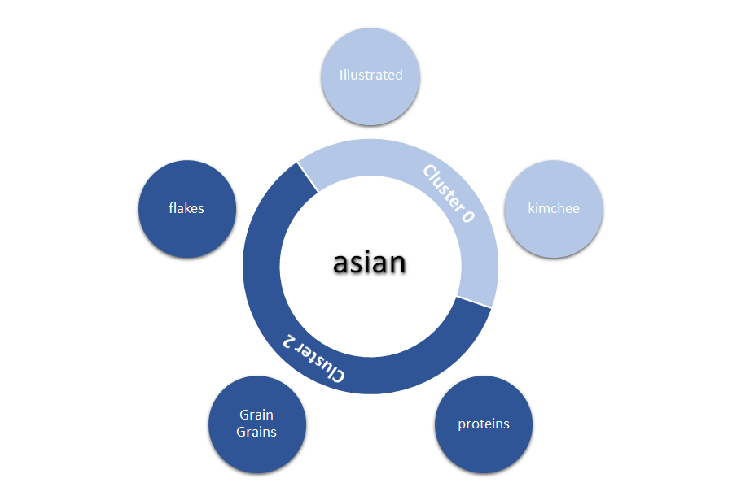
Implications on Reader’s Culture/BG
Implies Chinese like pickles?
Staple food
Notes:
what kind of diet are Chinese interested in? Or people are more interested in what kind of Chinese food? Here are results. Dumplings, barbecue, ribs, exactly fit our impression of Chinese food. What surprised me is how much Chinese love pickles.
Asians attach great importance to staple foods and they still love kimchee. ‘Illustrated’ may indicates that cookbook with pictures are more popular.

Slide 20
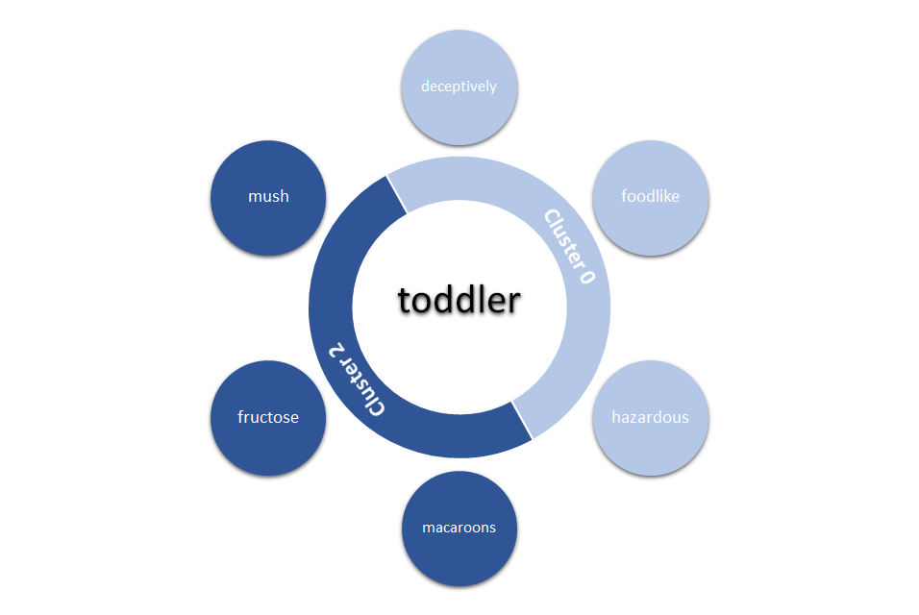
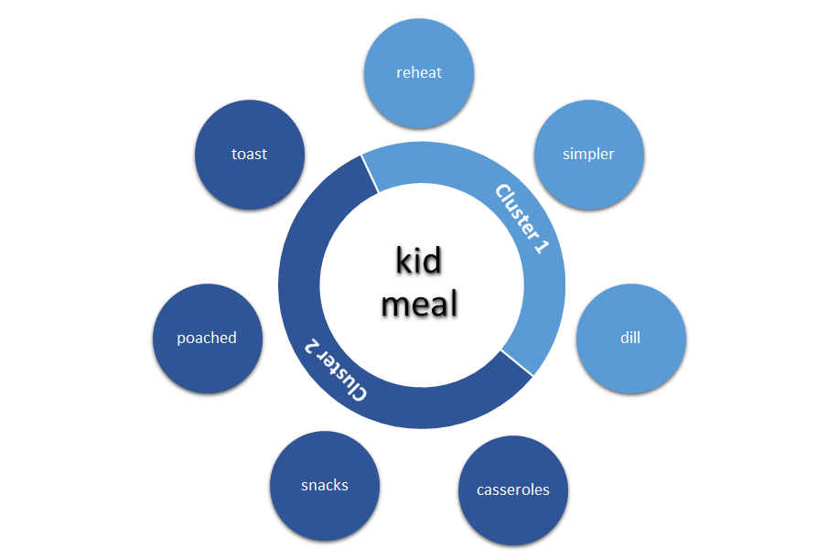
Implications on Cookbooks for Kids
How make the food they don’t like (Solid Food)
Let Moms easy to prepare lunch
Notes:
For toddler, their food should be easy to swallow and digest, like mush. Famous chief may share more complex recipes, like macaroons. In cluster0, easy to cook, moms are more focused on how to let their children eat something may be good to them but they don’t like, like carrots or something.
And these are words similar to ‘kid’ and ‘meal’.

Slide 21
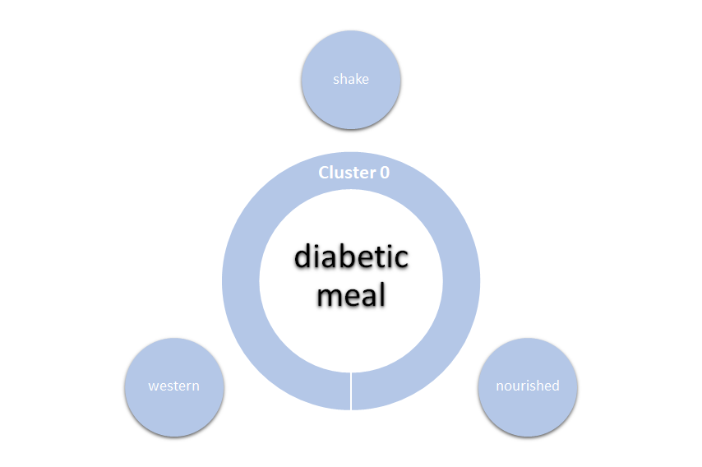
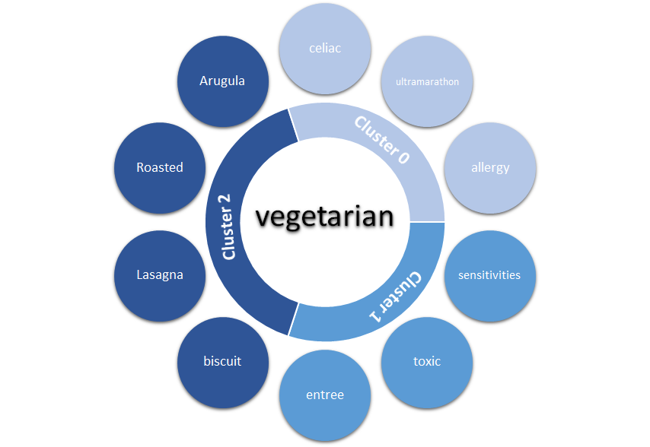
Implications on Special Diets
More complicate recipe
Satiety and nutritious food, but without starch
More care about health

Slide 22
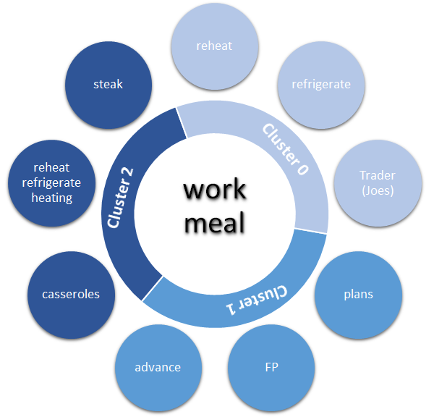
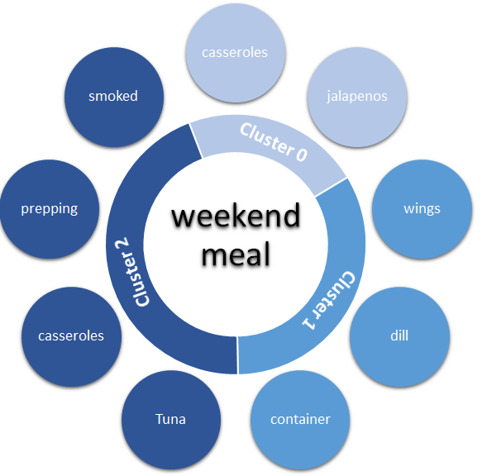
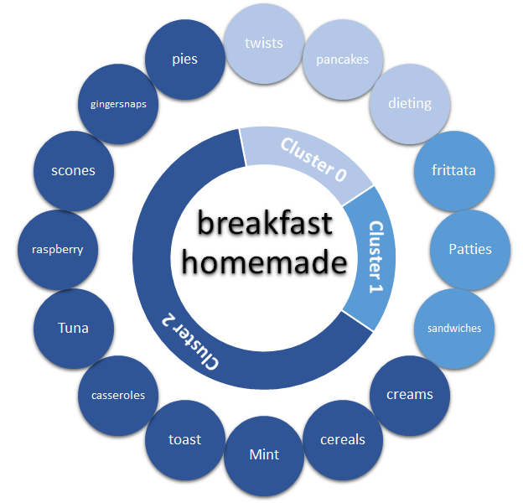
Implications on Work vs Life
Work Class Preferences?
Long time to prepare and cook
Housewife and weekend

Slide 23
Consumer Behaviors & Business Insights
Housewives are an important part of the cookbook readers, whereas different ages of the group have different preference in terms of cooking recipes and styles.
Understanding the culture makeup of the readers is important, as one might think asians loves pickles, but do they?
Special groups of target readers/beneficiaries, such as toddlers/kids, have special needs in terms of nutrition, whether a easy recipe can fulfill these requirements remain a question.
Taking into account of the work-life balance of the readers is also an important takeaway for the Cookbook publishers, e.g. Work Class prefers frozen food or food that is easy to cook in minutes.

Slide 24
Other Conclusions from Analysis
3 Main Areas in Cookbooks:
Easy-To-Cook
Diet & Health (Keto, Vegan, Gluten)
Famous Chefs
Negative reviews tend to focus on these aspects:
Authors, Price, Waste-of-time
Novel Aspects:
Herbs, Detox, Ayurveda - Seeking Cure From Food?
Infused Water seemed to be a tough topic to write on

Slide 25
Q&A
Thank you!

